Slide 1

GYM MANAGEMENT SYSTEM
RNS INSTITUTE OF TECHNOLOGY
BENGALURU - 98
DEPARTMENT OF INFORMATION SCIENCE & ENGINEERING
Presentation on Internship
Varsha PS
USN: 1RN18IS118
TechieAid
Internal Guide
Mr. T.S.Bhagavath Singh
Asso. Prof. Dept of ISE, RNSIT
External Guide
Mr. Ramesh Nediyadath
TechieAid

Slide 2
AGENDA
Abstract
About the Company
Introduction
Literature Survey
Requirements
System Design
Detailed Design
Implementation
Testing
Conclusion and Future Enhancements
References
Q & A

Slide 3
ABSTRACT
Gym Management system is the solution for all the fitness centres to manage its members and their respective information in an easier and more convenient way. The administrator is the user in this system. Since it’s a tedious job to maintain the record of each and every member of the gym using paper work, this mini project serves as best tool for management of data.
This mini project is basically developed to aid the user to perform certain actions like adding a new member to the gym, managing payments, workout routines etc. The user shall be able to add the name, date of birth, contact address of the member, exercise routine and month of joining the gym. It also records the phone numbers, height, weight and calorie count of every member.

Slide 4
It also has option for maintaining the payment transactions. This helps the user to know about fee payments and select the type of exercise routines like monthly, quarterly, 6 months or annually depending on the choice of the member. It also holds the receipt number and the amount of fees paid. The health status of each and every member is maintained and updated frequently. Admin can be managing, adding and updating the information of the members of the gym by overcoming the limitations and drawbacks of the conventional paperwork

Slide 5
About the Company
We are IT services company registered under Govt. of India, Ministry of Micro, Small & Medium Enterprise (MSME).
We offer Software Development Services, Staffing Solutions, Technology Training, Leadership & Soft Skills Training and Coaching & Mentoring TechieAid core team comes with 20+ years of industry experience Our Mission is to empower our customers with necessary knowledge, skills and resources for them to succeed in their endeavors.

Slide 6
INTRODUCTION
The purpose of the “Gym Management System” is to provide a system which handles the information of the people coming into the gym and maintaining their health care. The main motivation behind the selection of this project was to design, develop and implement software which will be a platform for management of all aspects of the gym. Further, to make the application user interactive and user-friendly, Web technologies like PHP, CSS, JavaScript and HTML5 are used.
This Gym Management System is developed to provide the following services:
The Administrator can add new members to the gym by adding their credentials like name, address, phone number, joining date and exercise routine.
Health status of each and every member can be stored along with their calorie count, height, weight and remarks from their trainer.

Slide 7
contd
Payment status of every member is maintained along with the exercise routine, joining date and expiry date of their plan.
Workout routine is included which includes four plans namely Annual, 6 months, Quarterly and Monthly.
Admin profile can also be changed by providing the previous password and updating the credentials of the new one.

Slide 8
LITERATURE SURVEY
Kasliwal Mahima , Raundal Pooja , Wagh Niyati, G.M. Lodha , “Survey Paper on Gym Management System” , Journal of Advancement in Software Engineering and Testing Volume 2 Issue 3. In this paper the authors have mentioned the feature where you can login as admin and manage the customer/user details, which I have implemented in this project also learnt how to add certain categories like the user’s age , weight , height , etc as one of the informations to go into the database.
Eric Huong,“ Gym Review”, Scribd Research Volume 13. In this paper the author mentions about how physical fitness is important and how in this era that we live in Gym industry is booming and more and more help is needed in bringing them up for a profitable lifestyle, This lead me to come up with building this website which will be used so much now in the market and will also be benefitial to the fitness market.

Slide 9
Sanja Delcev , Drazen Draskovic , “ Modern Javascript Frameworks : A Survey Study” , Date of issue: 30 May 2018 , Added to IEEE on 30th August 2018 , DOI :10.1109/ZINC.2018.8448444 , the author here mentions that JavaScript is used in today's web applications as a client script language and on the server side. The JavaScript language supports the Model View Controller (MVC) architecture that maintains a readable code and clearly separates parts of the program code. The topic of this research is to compare the popular JavaScript frameworks: AngularJS, Ember, Knockout, Backbone. All four frameworks are based on MVC or similar architecture , this sounded as an appropriate framework to use in my project and thus I developed my website using Js as the Backend.
A.V Dinesh Kumar , K Bhargav Ram Rayal, M.Saraswathi , “Smart Gym Management System “ , SCSVMV University, Elanathur Kanchipuram – 631561 , I learnt that Increasing efficiency and effectiveness automation, accuracy, user-friendly interface, information availability, communication capacity, maintenance, cost reduction makes our system smarter than the existing system.

Slide 10
Requirements
A Requirement Specification of a system includes Software Requirements Specification (SRS) and Hardware Requirements Specification. It lays out functional and non-functional requirements and may include a set of use cases that describe user interactions that the software must provide.
Hardware requirements
Processor : Intel Pentium 4
Processor Speed : 2.4 GHZ
RAM : 1GB

Slide 11
Operating System : Windows 10
Front End Design : HTML5, CSS
Client-Side Scripting : CSS3
Server-Side Scripting : Php
Web server : Apache 2.0
Database : MySQL

Slide 12
contd
Functional requirements – Admin
Each user has his separate account, to perform his own functionalities, identified by a user name and password. Every user is made to create an account before using the application. Only by providing the credentials he/she can log in to the main page, else an error message will pop up.
Security requirements
It is of utmost importance to ensure that there is protection against unauthorized access to the main page. Users must be provided with a login ID and password which grant access only to their respective account. The admin has privileged access in order to view all data and ensure seem less and efficient workout routines to all the members of the gym.
Performance requirements
The PCs used must be at least being INTEL PENTIUM machines so that they can give optimum performance of the product. In addition to these requirements, the system should also embrace the following requirements: -
Reliability: The system should have little or no downtime.
Ease of Use: The general and administrative views should be easy to use and intuitive.

Slide 13
contd
Design and Interface requirement:
The designers must design the database is such a way that any change in the information of a client should be updated and saved effectively in the database.
The interface which is provided in this software allows the user to manage and update the information about the members, their health status, payments, workout plans and membership. The database designed should be very easy to use and user friendly.
An account is maintained for every user to ensure security and anonymity.
User can manage, update all the data in his database.
Communication between the MySQL database and front-end is through a XAMPP server. It is connected with front-end with a connection, established through PHP, which has inbuilt functions for connectivity.

Slide 14
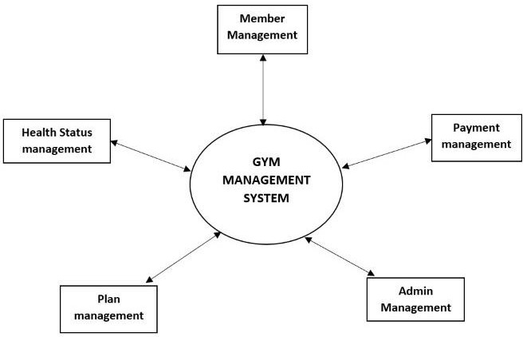
System Design

Slide 15
Design of the system
A Data Flow Diagram (DFD) is a graphical representation of the "flow" of data through an information system, modeling its process aspects. A DFD is often used as a preliminary step to create an overview of the system without going into great detail, which can later be elaborated. DFDs can also be used for the visualization of data processing (structured design).
A DFD shows what kind of information will be input to and output from the system, how the data will advance through the system, and where the data will be stored. It does not show information about process timing or whether processes will operate in sequence or in parallel, unlike a traditional structured flowchart which focuses on control flow, or a UML activity workflow diagram, which presents both control and data, flows as a unified model.
Figure 3.1 shows the data flow diagram for the Gym Management System. It illustrates the flow of data from and to the Gym Management in the system. The administrator can add new

Slide 16
member to the database, as well as make payment transactions, maintain health status of each and every member, workout routine management and finally updating or adding a new admin profile to the system. The system uses a MySQL database to store all the required information in the form of relational tables. In response to user input, the system uses the database to store the member information, their health status, payment transactions, workout routines and admin information.

Slide 17
Detailed Design
A Use-Case Diagram (UCD) at its simplest is a representation of a user's interaction with the system that shows the relationship between the user and the different use-cases in which the user is involved. A use-case diagram can identify the different types of users of a system and the different use-cases and will often be accompanied by other types of diagrams as well.
Figure 3.2 shows the use-case diagram for the Gym Management System. It illustrates the different actions that can be performed by administrators in order to interact with the application. Administrator can add a new member to the database, add new payments, update and add health status of each and every member of the gym, new workout routines, plans and also edit or add new admin profile to the database.

Slide 18
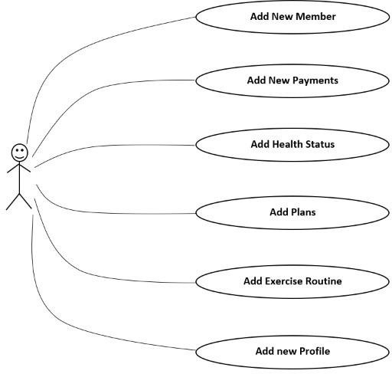
Use case diagram

Slide 19
Implementation / Coding
Database connection
The below code shows how to establish connection with database
<?php
define('DB_HOST','localhost'); define('DB_USER','root');
define('DB_PASS',''); define('DB_NAME','carrental'); try{$dbh = new PDO("mysql:host=".DB_HOST.";dbname=".DB_NAME,DB_USER, DB_PASS,array(PDO::MYSQL_ATTR_INIT_COMMAND => "SET NAMES 'utf8'"));
} catch (PDOException $e)
{ exit("Error: " . $e->getMessage());}

Slide 20
Admin login
The below code shows how admin logs in to the system by providing the credentials
<?php
session_start(); include('includes/config.php'); if(isset($_POST['login'])){
$email=$_POST['username'];
$password=md5($_POST['password']);
$sql ="SELECT UserName,Password FROM admin WHERE UserName=:email and Password=:password";
$query= $dbh -> prepare($sql);
$query->bindParam(':email', $email, PDO::PARAM_STR);
$query->bindParam(':password', $password, PDO::PARAM_STR);
$query->execute();
$results=$query->fetchAll(PDO::FETCH_OBJ); If($query->rowCount() > 0){
$_SESSION['alogin']=$_POST['username'];
echo "<script type='text/javascript'>document.location = 'dashboard.php';

Slide 21
Health status
The below code shows the health status of the members
<?php if(isset($_POST['submit'])){
$calorie=$_POST['calorie'];
$height=$_POST['height'];
$weight=$_POST['weight'];
$fat=$_POST['fat'];
$remarks=$_POST['remarks'];
$userid=$_POST['usrid'];
$query="update health_status set calorie='".$calorie."', height='".$height."',weight='".$weight."',fat='".$fat."',remarks='".$remarks."' where uid='".$userid."'";
if(mysqli_query($con,$query)){
echo "<head><script>alert('Health Status Added ');</script></head></html>"; echo "<meta http-equiv='refresh' content='0; url=new_health_status.php'>";
}

Slide 22

Design
Figure 5.1 shows the Homepage of the Gym Management System displayed before user’s login.

Slide 23
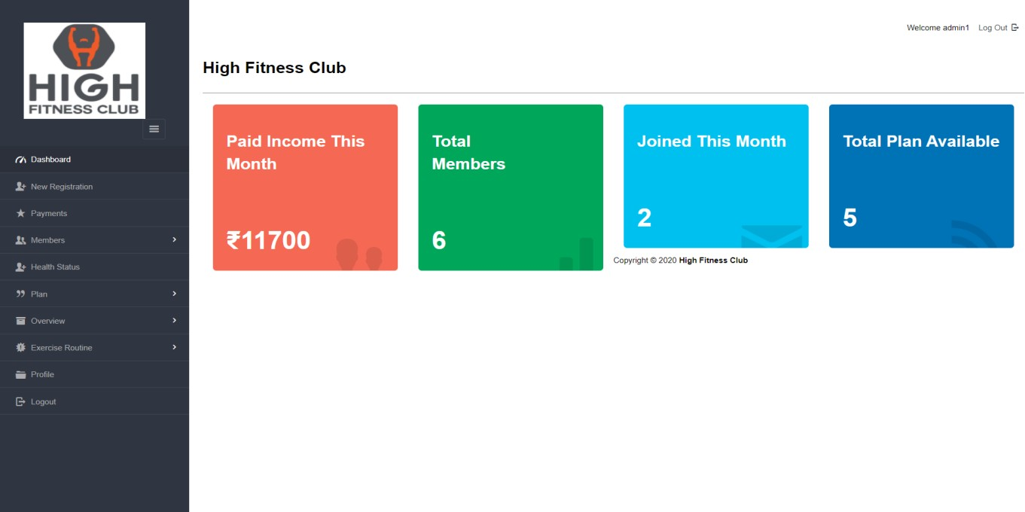
shows the Home page which is displayed after the user logs in to the system

Slide 24
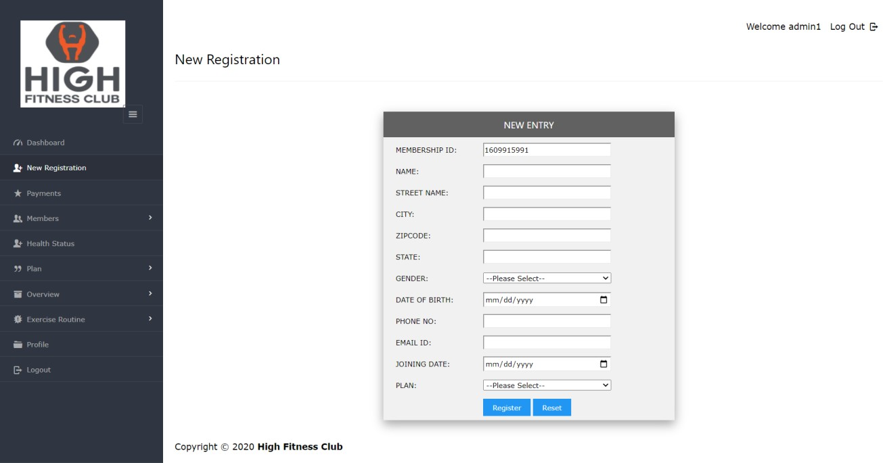
shows the Registration page where the admin enters all the details if the user

Slide 25
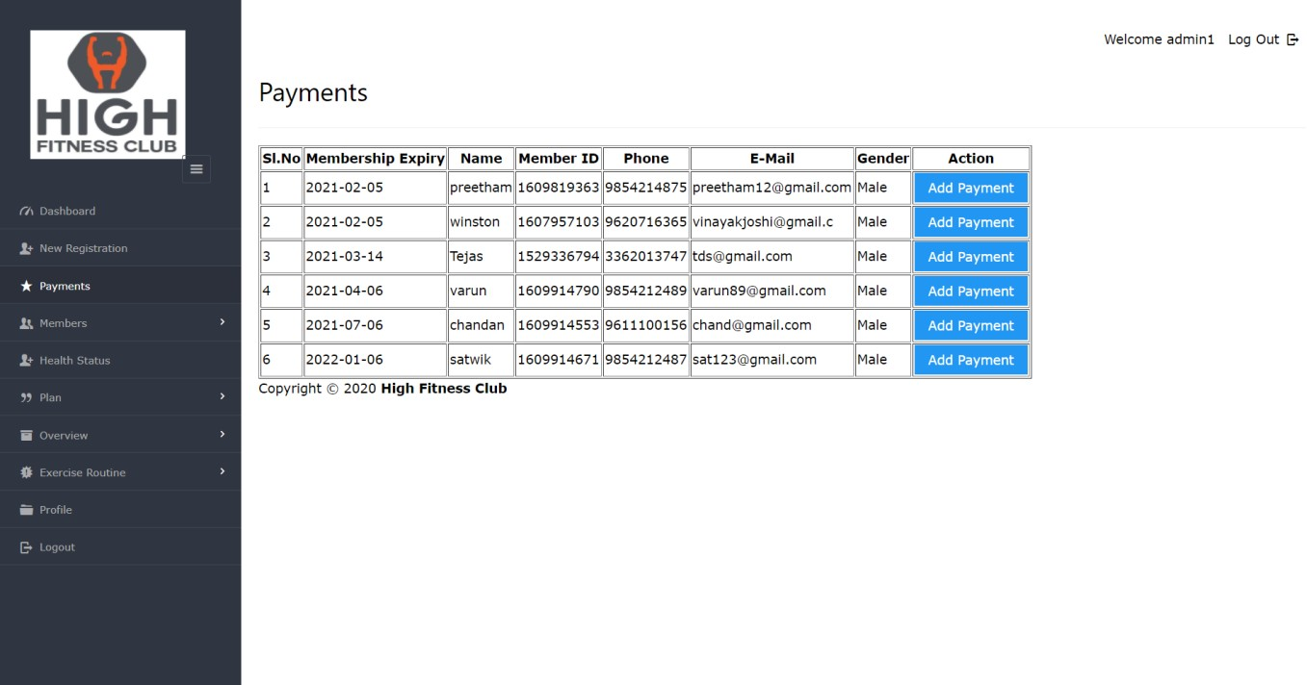
shows the Payments page which consists of all the transactions on the members

Slide 26
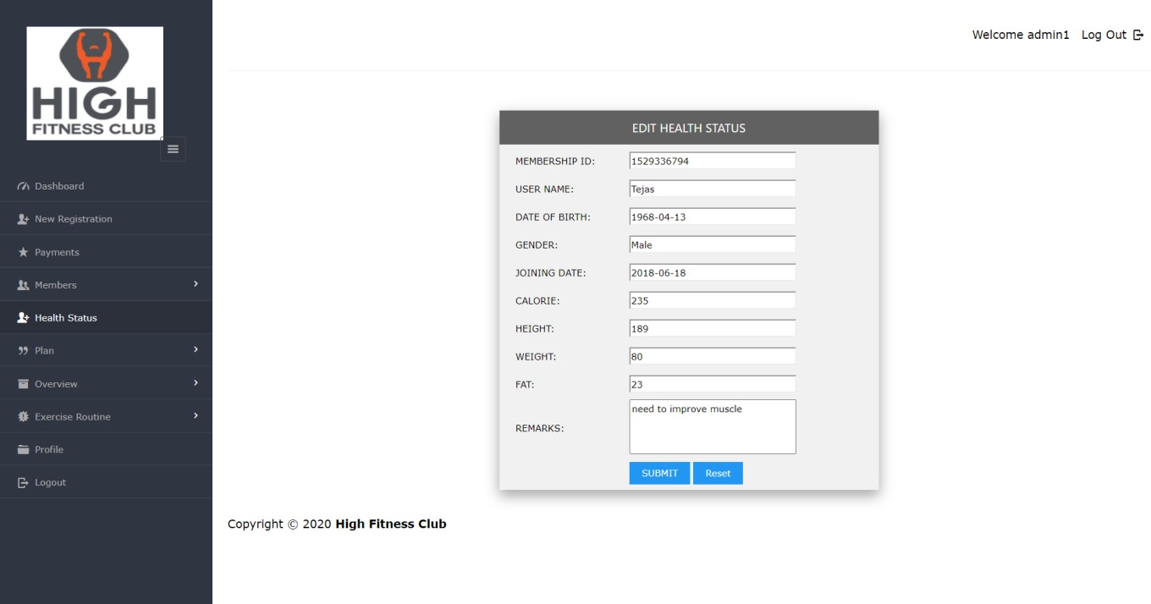
shows the Health status of the members which is maintained by the administrator

Slide 27
shows the Workout routines which can be added, updated by the administrator

Slide 28
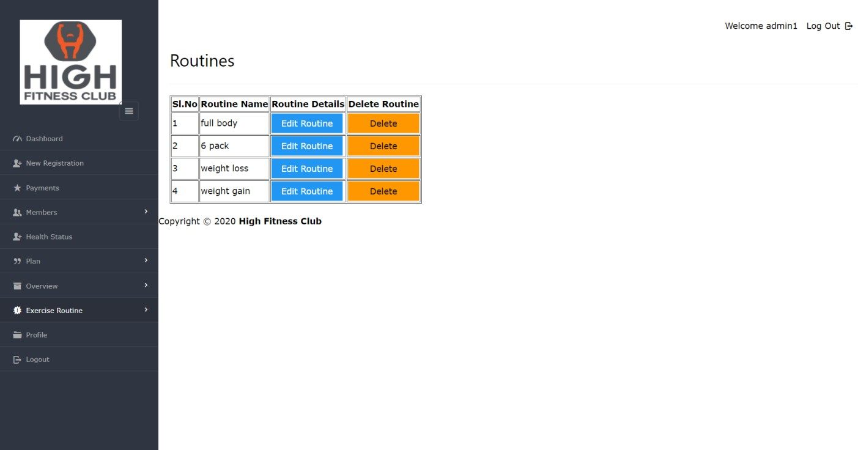
contd

Slide 29
CONCLUSIONS
The system was mainly designed to reduce the manual work of registering every time a new member registers to the gym and maintain his/her health status. It also provides flexible and powerful reports regarding members, payments, workout routines, plans, health status.It organizes, maintains and updates the entire database which eases the work of the administrator.

Slide 30
Future Enhancements
The future enhancements that can be made to this mini project are:
We can add an extra user login page which directs the user to the pages where he/she can manage their credentials.
A way to register for members and subsequently login to their workout routine.
Workout videos, inspirational quotes when the members login to their account which can be customized by them based on their likes and dislikes
A shopping option for the required supplements, material that can be added to their cart, bought and delivered to their mentioned address.

Slide 31
REFERENCES
Raghu Ramakrishnan and Johannes Gehrke , Database Management Systems , McGraw HILL , 3rd Edition.
Rameez Elmasri and Shamkant B. Navathe , Fundamentals of Database Systems , Pearson
, 7th Edition.
Randy Connolly, Ricardo Hoar, "Fundamentals of Web Development”, 1stEdition, Pearson Education India.
Robin Nixon, “Learning PHP, MySQL &JavaScript with jQuery, CSS andHTML5”, 4th Edition, O’Reilly Publications, 2015.
Luke Welling, Laura Thomson, “PHP and MySQL Web Development”, 5th Edition, Pearson Education, 2016.
Nicholas C Zakas, “Professional JavaScript for Web Developers”, 3rd Edition, Wrox/Wiley India, 2012.
www.php.net
www.javascript.com

Slide 32
Question and Answer

Slide 33
THANK YOU

